Slide 1

ENHANCING PING AND TRACEROUTE
June 3, 2021

Slide 2
Credits
Developers (Harvey Mudd College)
  Ishaan Gandhi
  Andreas Roeseler
  Spencer Lang
  Nick Ludwig
Mentors
  Ron Bonica (Juniper Network)
  Zach Dodds (Harvey Mudd College)

Slide 3
THE IP OAM TOOLKIT
PING and TRACEROUTE are the most commonly use tools in the IP OAM Toolkit
What do they do?
How do they work?
What can’t they do?
How can they be enhanced?
Notes:
Most commonly used tools in toolkit
However, as we’ll see in this presentation, they have some limitations and cannot always provide us the information about the network that we would want. Specifically, there are many instances where these tools can only provide us information at the NODE level, and not the interface level, where a NODE is something like a router or a host on a network that communicates to other NODES through its interfaces
For the rest of this presentation, we’re going to look at Ping and Traceroute and follow the structure outlined here, where we will examine what they do, how they work, what they can’t do, and how we have been working to enhance them this year.

Slide 4
PING

Slide 5
WHAT DOES IT DO?
Test the liveliness of a reachable interface
Test the liveliness of a reachable node
  By testing the liveliness of one of its reachable interfaces
Notes:
Commonly used to test the connectivity of a node and is often the first step in debugging a network

Slide 6
HOW DOES IT WORK?
A probing node sends an ICMP Echo to a probed interface
The probed interface sends an ICMP Echo Reply to the probing node
Nerd Notes
  The ICMP Echo may enter the probed node through any of its interfaces
  The ICMP Echo reply message may leave the probed node through any of its interfaces
  There is no guarantee that that either ICMP message traverses the probed interface
Notes:
Before Nerd Notes
However, what if we want to learn about a specific interface on a node, and determine if that interface is up. Here we run into problems with the current ping command because the…

Slide 7
WHAT CAN’T IT DO?
Test the liveliness of less-than-reachable interface
Examples of less-than-reachable interfaces
  IPv4 unnumbered
  IPv6 unicast with narrowly scoped address (link-local, ULA)
  Any interface to which the probing node lacks a route

Slide 8
HOW CAN IT BE ENHANCED? [RFC 8335]
A probing node sends an ICMP Extended Echo Request to a proxy interface
  ICMP Extended Echo Request identifies the probed interface
The proxy interface sends an Extended ICMP Echo Reply to the probing node
  The extended ICMP Echo Reply reports the liveliness of the probed interface
Notes:
The proxy interface then reads this identifier, and responds with an Extended ICMP Echo which can tell us information about the probed node. Thus, we can get more specific information about an interface on a node, and we can learn about interfaces we could not otherwise query.

Slide 9


How is interface 3?
Nick’s
Machine
1
2
3
Interface 3 is up.
NL
Notes:
...this motivated Probe. Probe addresses x, y, z by doing a, b, c

Slide 10
RFC 8335 NERD NOTES
The proxy interface can be different from the probed interface
  And is different in most cases
The proxy interface must be reachable from the probing node
The proxy interface must reside on one of the following
  The same node as the probed interface
  A node that is directly connected to the probed interface

Slide 11
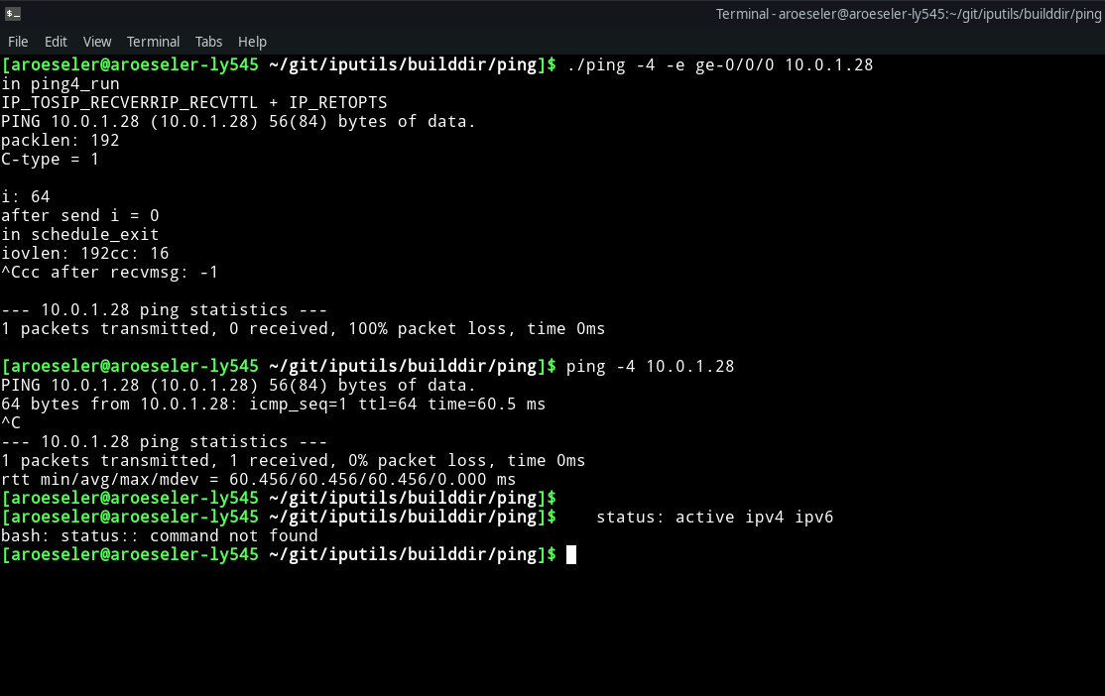
Example Usage

Slide 12
SECURITY CONSIDERATIONS
Not enabled by default
Accessible from specified source addresses only

Slide 13
IMPLEMENTATIONS
JUNOS 20.3R1
LINUX Kernel(5.13)
LINUX IP Utils Ping (in progress)
Wireshark (3.5)
TCPDUMP (in progress)

Slide 14
TRACEROUTE
Notes:
Now let’s switch gears to traceroute, and we’ll have a similar structure to ping. We’ll talk about what traceroute does, how it works, what its limitations are, and what we’ve done to address these issues.

Slide 15
WHAT DOES IT DO?
Elicit feedback from each node on the delivery path between a probing interface and a destination interface
Identify nodes along the delivery path
Notes:
This tool is used to try to learn what path our messages are taking through a network.

Slide 16
HOW DOES IT WORK?
A probing node sends a series of UDP packets to a destination interface
  Sets the TTL to 1 on the first packet, so that it expires on the first node along the delivery path
  Increments the TTL on each subsequent, so that it expires on the next node along the delivery path
When a packet expires on a node along that delivery path, that node sends a ICMP Time Expired message to the probing node

Slide 17
NERD NOTES
Regarding the UDP probe messages
  By default, on the first packet, the probing node sets the UDP destination port to 33434
  Increments UDP destination port on each subsequent packet
Regarding the ICMP Time Expired message
  The source address may not identify the interface upon which the UDP probe message arrived
    IPv4: Identifies the interface through which the ICMP message left the reporting node
    IPv6: It’s complicated. See RFC 6724.

Slide 18
WHAT CAN’T IT DO?
Identify interfaces along the delivery path

Slide 19
HOW CAN IT BE ENHANCED? [RFC 5837]
UDP Probe message is unchanged
ICMP Time Expired message can contain extensions that identify
  Interface upon which the UDP probe message arrived
  Interface through which the message would have been routed had the TTL not expired
  Attributes of those interfaces (name, IP address, MTU)

Slide 20
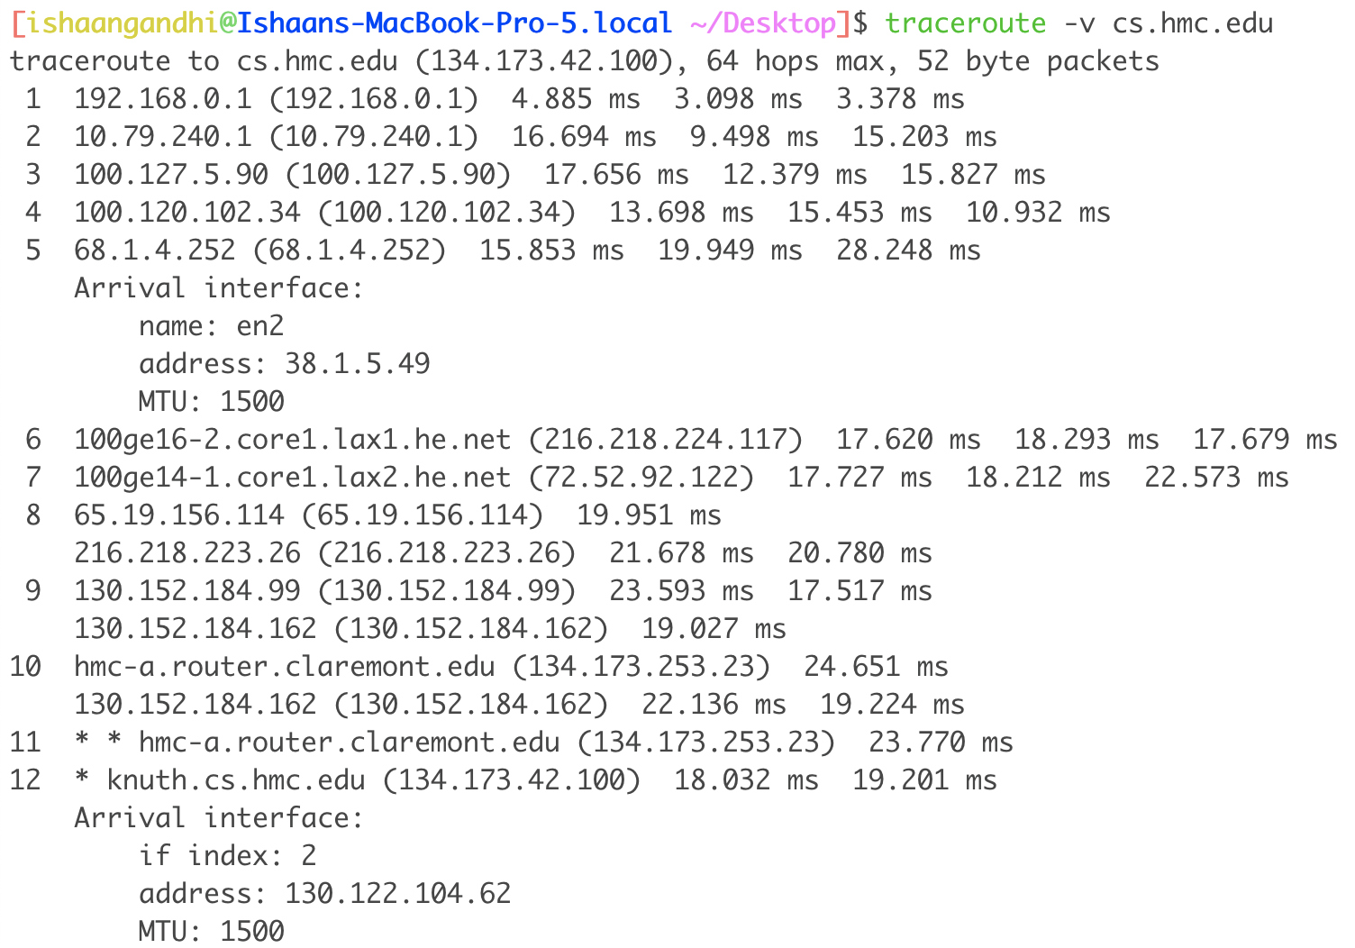
Example Usage

Slide 21
SECURITY CONSIDERATIONS
Not enabled by default
Accessible from specified source addresses only

Slide 22
IMPLEMENTATIONS
JUNOS (in progress, EX first)
LINUX Kernel (in progress)
LINUX IP Utils Traceroute (in progress)
Wireshark (3.5)

Slide 23
Ron Bonica, Ishaan Gandhi, Spencer Lang, Nick Ludwig, Andreas Roeseler

